Slide 1
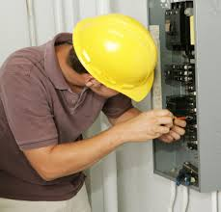
Electrician
Lance Sitko, 2nd hour, 2/7/14, Computer Tech

Slide 2
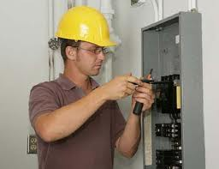
Introduction
Choose a job you love, and you will never have to work a day in your life. ~Confucius. I agree with this quote. But I will never know if I love being a electrician until I try it out. In order to get a better understanding of my career as a cake decorator, I will be researching the nature of the work, working conditions, training, qualifications, advancement, job outlook/employments, earnings, and a related occupation.

Slide 3
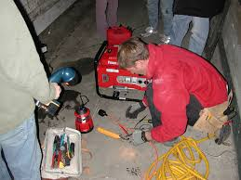
Nature of Work (responsibilities)
Read blueprints or technical diagrams
Install and maintain wiring, control, and lighting systems
Inspect electrical components, such as transformers and circuit breakers
Identify electrical problems with a variety of testing devices
Repair or replace wiring, equipment, or fixtures using hand tools and power tools
Follow state and local building regulations based on the National Electric Code
Direct and train workers to install, maintain, or repair electrical wiring or equipment

Slide 4
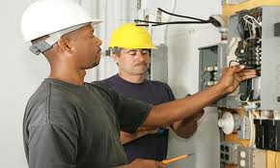
Working Conditions
cramped spaces
standing and kneeling
indoors and outdoors
higher rate of injuries and illnesses
work full time
Mental

Slide 5
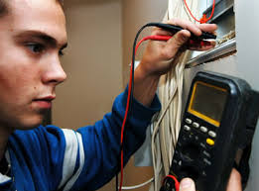
Training, Qualifications, Advancement (Education)
High school diploma.
18 years old.
Algebra
4-5 year apprenticeship
Class needed in Lake Shore: Building Renovation

Slide 6
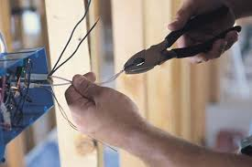
Job Outlook
Employment grow 20 percent from 2012 to 2022
Location where I want to work: Nevada
Where: indoors

Slide 7
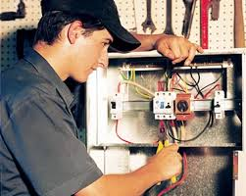
Earnings
Median wage: $49,840
Own a 2-story house: +
Own a company: -
Own a fancy lock: -

Slide 8
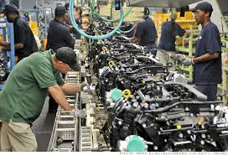
Manufacturing
Review production schedules, engineering specifications, process flows, and other information to understand methods and activities in manufacturing and services
Figure out how to manufacture parts or products, or deliver services, with maximum efficiency
Develop management control systems to make financial planning and cost analysis more efficient
Enact quality control procedures to resolve production problems or minimize costs
Work with customers and management to develop standards for design and production
Design control systems to coordinate activities and production planning to ensure that products meet quality standards
Confer with clients about product specifications, vendors about purchases, management personnel about manufacturing capabilities, and staff about the status of projects
Where: Anywhere
Why: I want a high paying job.
Pay: $78,860 per year

Slide 9
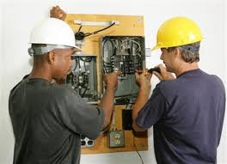
Conclusion
After researching about being a electrician, I am not very interested in this career anymore. Low pay, bad work environment and full time. I am interested in being a manufacturer though. They get high pay and the most important thing in life is food. So I need money to get food so survive.

Slide 10
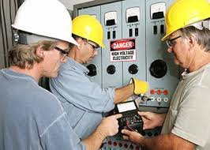
Works Cited
ooh

